Slide 1

The Effect of eLearning on Nigerian Tertiary education
BABATUNDE AHMED

Slide 2


The effect of this emerging technology has changed the way humans do things, socialize and educate themselves.(Udochukwu et al., 2019)

Slide 3
Ajadi, Salawu and Adeoye (2008)
The history of E-learning in Nigeria can be traced to the development of the country's telecommunication sector in 1886.
Since then, The introduction of eLearning has helped to promote adult education by providing multiple learning choices through the use of various technologies that make learning easier and faster (Oguzor, 2011).

Slide 4
0.3M
According to Statista reports (2022),, there will be a total number of sers of E-learning platforms in Nigeria by 2026
Users of E-learning platforms in Nigeria by 2026

Slide 5
Significance Of Stucy
Analyze the effects of eLearning from the student perspective?
Provide tutors, software engineers and IT managers with important information on how to improve their delivery?
A critical review of the student's interactions with eLearning tools.

Slide 6
Research Questions
What are the common tools for eLearning used in Nigeria?
What are the views of students on the use of e-learning in Tertiary education in Nigeria?
Has the use of these technologies aided or disrupted their learning process?

Slide 7
Aims and Objectives
“The aim of the research is to trace and identify elearning in the Nigerian situation. “
The major objectives of the research is to understand how students have used and adapted to technology and electronic resources in the learning environment. This research will report the use of various eLearning tools, student's view in terms of their access to facilities, preferences and benefits for eLearning in Nigeria.

Slide 8
Key literature related to the project
- COVID 19 pandemic opened a world for e-learning. - evaluated students' response to this shift from physical to virtual classes Camilleriee and Camillerie (2022)
- various ways eLearning is used in Nigerian Tertiary institution Udochukwu et al. (2019)
- improvement of student satisfaction in the e-Learning system Tanye (2017)
- benefits of e-learning to students in the Tertiary and adult education Tanye (2017)

Slide 9
How eLearning is used in Nigerian Teritary institutuons
Online examination
Computer based drills
Online books (E-books)
Online counseling
Udochukwu et al. (2019)

Slide 10
Benefits of E learning to Nigerian students (Olaniyi, 2006)
E learning reduces tuition fees and costs associated with purchase of books, study materials etc.
Most Digital courses are timely and flexible, allowing the students to work and learn.
E learning increases student understanding and retention through hands-on application more than traditional training methods.
It provides a means for tutors to monitor students progress in the course study through a school portal.
Short videos or hands-on exercises incorporated in e learning help to check if students have achieved the performance objectives at every stage of the course.
A user's progress is automated and can be monitored by or shared with one's supervisor

Slide 11
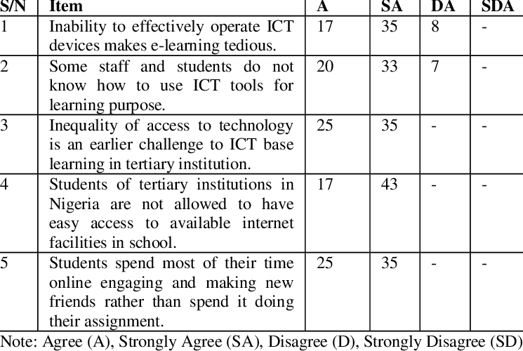
Udochukwu et al.(2019) investigated students and staffs attitudes to ICT tools in three Teritary institutuons.
72% Strongly agree to Item 4
58% Strongly agree to Item 1, 3 and 5
55% Strongly agree to 2

Slide 12
METHODOLOGY
METHODOLOGY
The research is literature based using a mix of both qualitative and quantitative data obtained from literature search of the keywords relating to the research topic.

Slide 13
The approach that this research will employ is the exploratory approach because the data will be collected from the library resources. The research will use the secondary data collection method because of the ease of accessibility of the data available on the effects of eLearning in Nigeria. This methodology is cost-effective and time effective.

Slide 14
Ethical considerations and risk assessment
.
As the study is a literature review of previously published or unpublished works, all authors whether academic researcher, journalists, government or institutional statistics used in the research will be properly cited and referenced using the appropriate referencing style.

Slide 15
Thank you for Listening!

